Slide 1
Finance PDE Project
Math 458 Professor Ricardo Mancera
Yuchen Shi
Wei Zhang
Ruiqi Wang

Slide 2
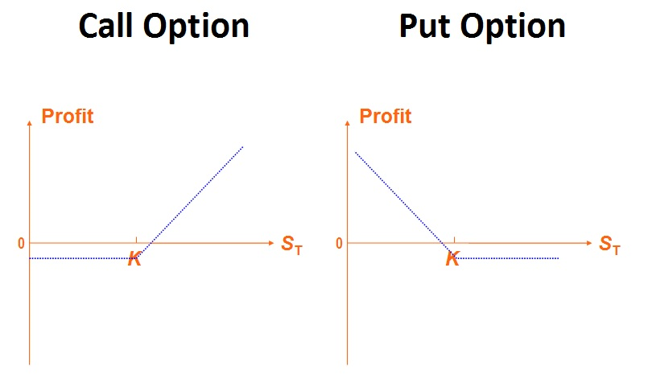
Financial Background
Put Option vs Call Option
Call option: A contract that gives the buyer the right, but not the obligation, to buy an asset at a specified price within a specific time period.
Put option: A contract that gives the buyer the right, but not the obligation, to sell an asset at a specified price within a specific time period.
American Option vs European Option
American Option: Allow early exercise.
European Option: No early exercise.

Slide 3
Objective
Pricing a 5-month American put option, when the stock price 𝑆0 = $50, the strike price 𝐾 = $50, the risk-free interest rate 𝑟 = 0.10 and the volatility 𝜎 = 0.4.
Mathematical Models:
Finite difference method
Black-Scholes-Merton formula
Crank-Nicolson method
Binomial tree approach
Put-call parity

Slide 4




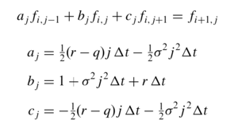
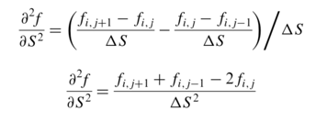
Implicit Finite Difference
Black-Scholes PED:
Finite differences: (i = 0, …, M represents time; j = 0, …, N represents stock prices)
Where i = 0, 1 … N - 1 and j = 1, 2 … M - 1

Slide 5
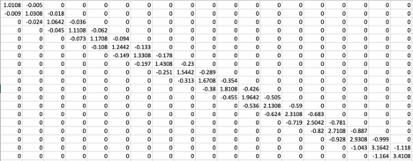
Tridiagonal Matrix
19*19

Slide 6

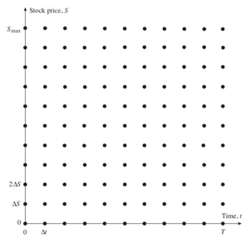


Initial Condition:
Boundary Conditions:
Early Exercise

Slide 7
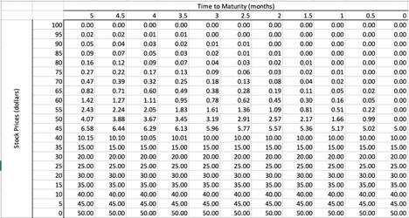
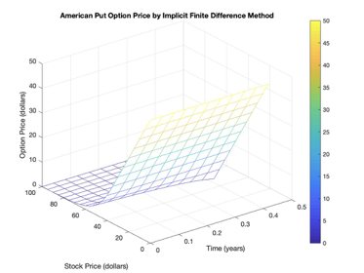
Stock Prices: $50
Option Prices: $4.07

Slide 8
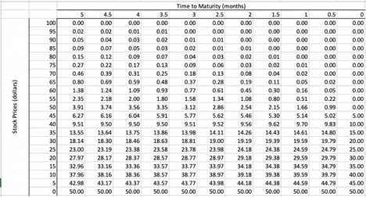
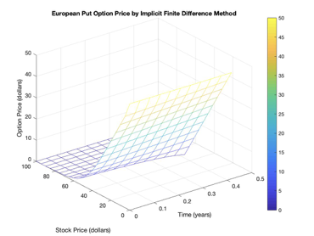
European Put Option
No early exercise; the rest of the procedure is the same as in pricing an American put option.
Stock Prices: $50
Option Prices: $3.91

Slide 9
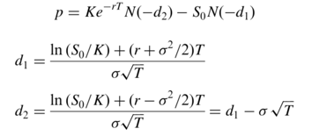
Black-Scholes-Merton formula
For European options, an analytical solution is available:
p = $4.08
The difference between the numerical solution and analytical solution is 4.08-3.91=0.17

Slide 10
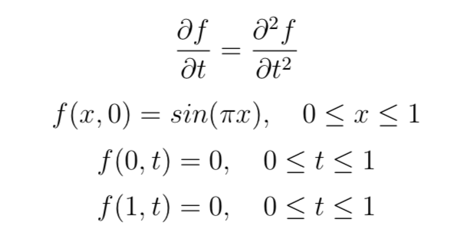
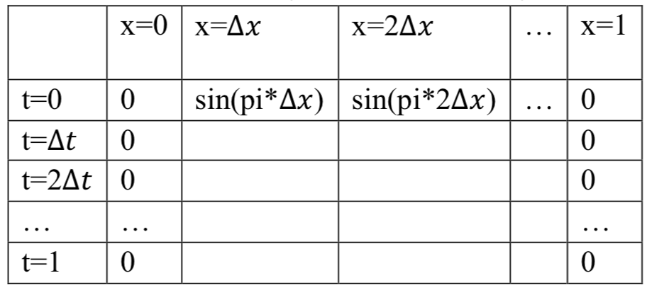

C) Solve the Heat Problem with Crank-Nicolson Method and Compare with the exact solution
Intro: The Crank–Nicolson method is an average of the explicit and implicit methods.
Set-up of the Heat Problem 2. Solving with Crank-Nicolson Method 3. Procedure in MATLAB
1. Solving with Crank-Nicolson M
Repeat this procedure for n-2 times, we can find all nodes at row j+1.
Starting from j =1, i = 2:n-2
Repeat this operation for row j = 2 : M

Slide 11
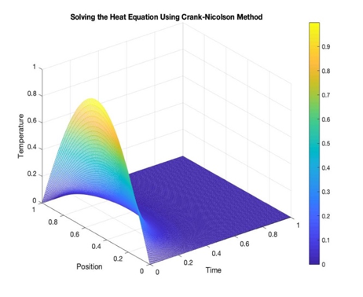

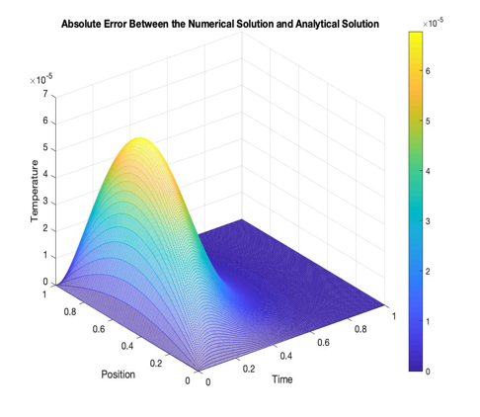
Result
The results from our numerical method are very similar to the results from the given analytical method. With a maximum absolute error (at a single node) = 6.7780 ∗ 10−5.
This shows that Crank-Nicolson method is very accurate and efficient for the heat equation.

Slide 12
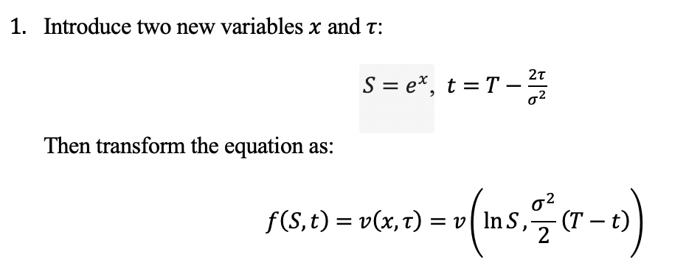
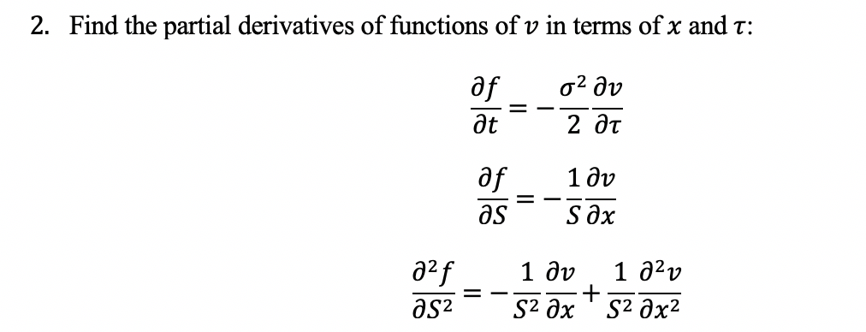
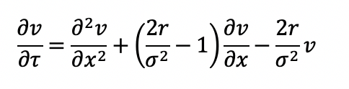
d)Transform the B-S equation into the Heat Equation
Objectives: Use find new functions and variables and use their derivatives to replace old variables in Black-Scholes model.
Process: Do twice “Variables→Derivatives→Replace”
Variables→Derivatives→Replace
b) c) 3. Substitute into the B-S equation :
and simplify

Slide 13
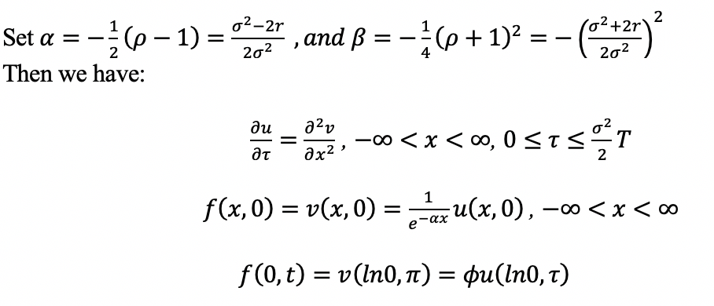
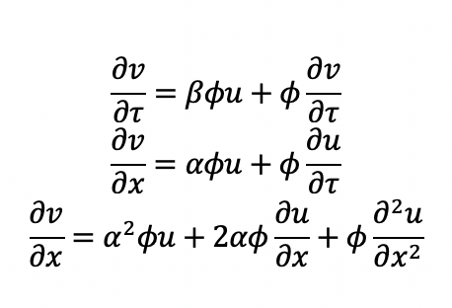
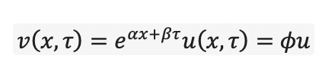
2. Variables→Derivatives→Replace
Introduce variables 𝛼 and 𝛽 : 2. 3 3.

Slide 14
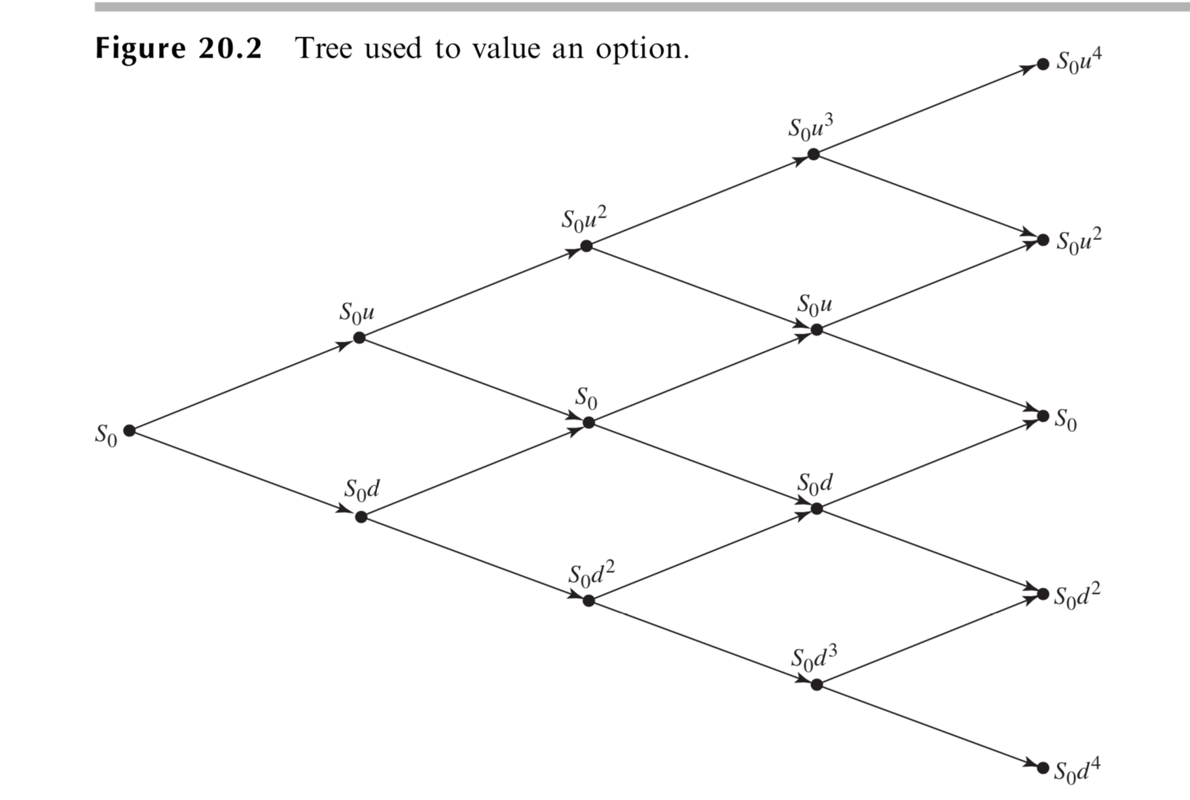


Binomial Tree Method
Divide the lifetime (T) of American put option into N subintervals with length Δt.
Use i to mark the time node,where
At time iΔt, we have i+1 combinations of movements for prices
j is the number of times the stock takes up movement, varies from 0 to i.
stock price :
p
1-p
i=0 i=1 i=2 i=3 i=4
Notes:
Binomial tree method is another popular way to price an option
In this method, stock price follows a random walk. Within each time step Δ t, the probability of an up movement is denoted as p , and the probability of a down movement is 1-p.
u is up rate, d is down rate
At each i node, we have i+1 possible values of stock price

Slide 15
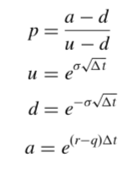
Question(e): Price an American put option using Binomial tree
Initial condition:
Stock price :So = $50
Strike price: K =$ 50
Risk free rate: r = 0.1
Volatility: σ = 0.4
q=0
T = 5 month = 5/12 = 0.4167
N = 5
Δt = T/N = 0.0833
Derive parameters:
Probability of up moving, p = 0.5073
Up step size,u = 1.1224
Down step size, d = 0.8909
Growth factor per step, a = 1.0084

Slide 16

Step1: Apply put option function
Given the stock price at final node (Sn) and strike price (K), apply put option function :
We obtain the option price at last column .
Step2: Work backwards through the tree
Define f i,j as the value of the option at the (i,j) node . Use the option price at (i+1)Δt to calculate the option price at iΔt.
Get a full grid, but needs to check each node at step 3

Slide 17
Step 3: Compare
Since American put option can be exercised at any time during its lifetime, which is any node that is profitable.
We have to compare the value of early exercised and value calculated from binomial tree model. Take the one with higher profit.
Finish update the grid.

Slide 18
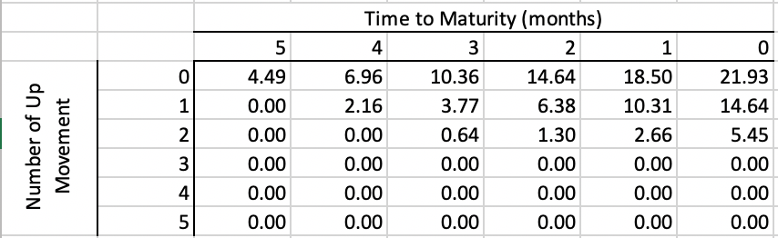
Result:
As we keep working backwards, the first node is the option price. Price = $4.49, when N = 5

Slide 19
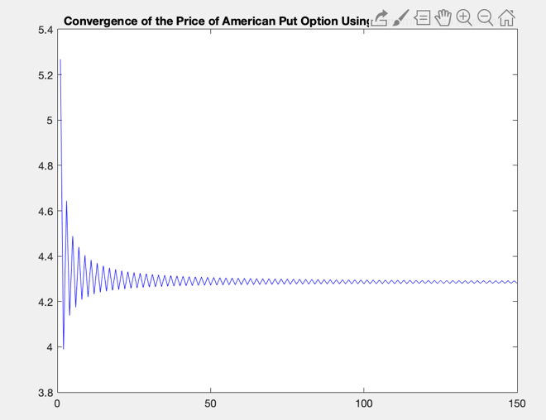
Question (f): Investigate convergence
By increasing N to 150, we obtain a plot as below:
As a result, the put option price converge to $4.28. From the plot, we can see when N increases to 50, the put price becomes stable.

Slide 20
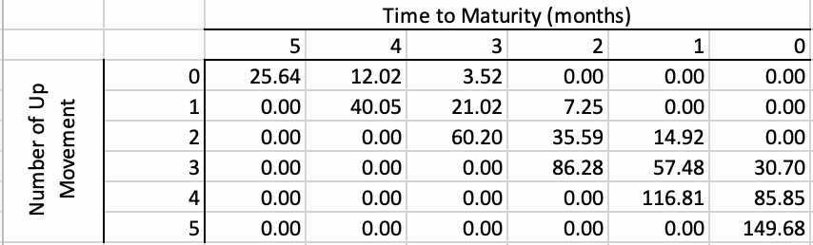
Question(g):
Price an European call option use Binomial tree
Since European option can only be exercised at the expiration time. We do not need to compare with the case of early exercised. Follow the step(1) and (2) in part (e), skip step (3). In addition, we use call function instead of the put function.
By the binomial tree model, we get price equals $24.80 when N =50. Since from part (f), we know the option price reaches stable when N increases to 50. Though the grid shows the case when N = 5, for the limitation of the graph size.
.

Slide 21

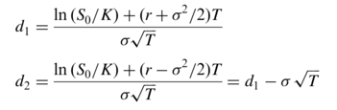
European Call Option
B-S formula:
c = $24.71

Slide 22
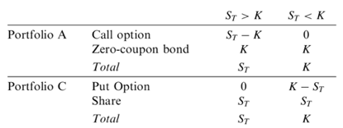


Put-Call Parity
Consider two portfolios:
Portfolio A has one European call option plus a zero-coupon bond that provides a payoff of K at time T.
Portfolio C has one European put option plus one share of stock.
p = $17.64

